Slide 1
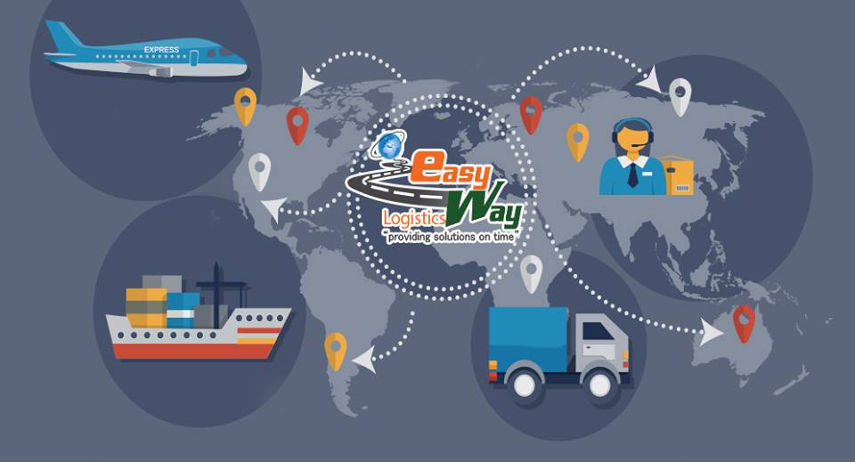

Fleet Organisational Chart

Slide 2
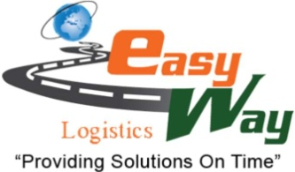
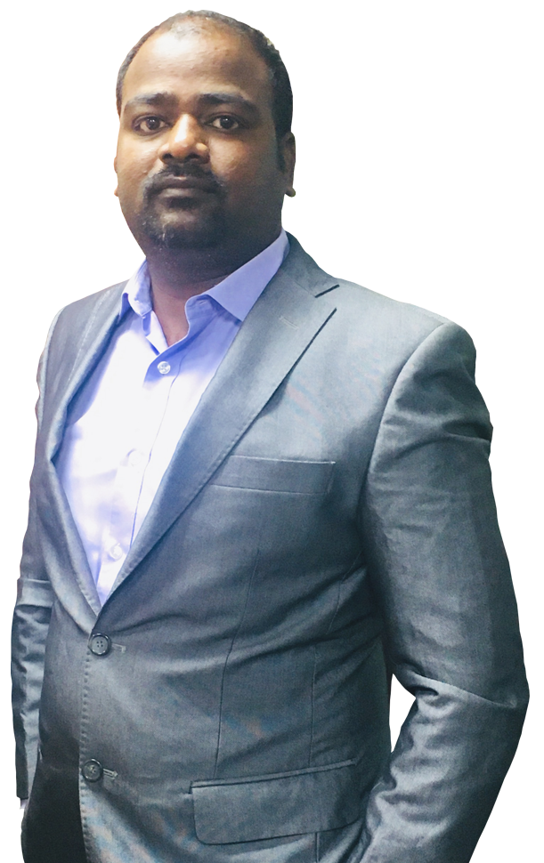
OUR CHAIRMAN
Easyway Logistics, established by Mr. Bhupathi Perumalsamy. Rendering administrations like Customs house broker (CHB) and International Freight Forwarding Agency
He built up this association amid the year 2012 with enthusiasm towards being one of the coordination's pioneer. His most committed endeavors and mastery which made EASYWAY an organization with a conspicuous brand esteem
Having 15 years of individual industry encounters with a solid base foundation of the exercises as to traditions clearing, cargo sending, venture taking care of, Transportation and so on,..
Here we pause for a minute to thank all our business partners and the staffs for their important help

Slide 3

About EASYWAY
EasyWay Logistics, the fast growing logistics service provider caters to our Customers’ requirements in terms of International Freight Forwarding. Being at the forefront has enabled us to offer a great deal of expertise in the custom clearing and forwarding industry.
Licensed Customs House Broker(CHB)
International Logistics Solutions provider
Supplier of thorough Logistics administrations which additionally incorporates way to-entryway payload developments via Air and Sea through our worldwide systems.
Resolved to build up long haul associations with our clients by reliably offering magnificent services administration.
Having own/Networking workplaces on dish India premise

Slide 4
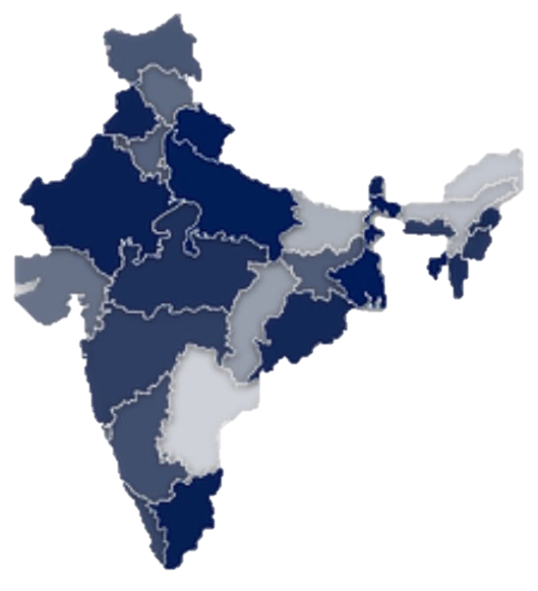








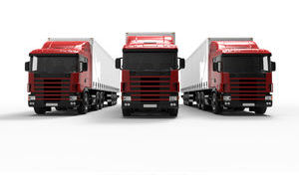
EASYWAY BRANCHES AND NETWORKING
Networking Office, Hyderabad
Branch Office, Krishnapattnam
Branch Office, Bangalore
Head Office, Chennai
Netwroking Office, tuticorin
Networiking Office, Madurai

Slide 5
MILESTONES
2019
Bangalore
EASYWAY LOGISTICS
Headquarter
2018
Hyderabad
2012
Chennai
2019
Tuticorin
2018
Krishnapatnam
2016
Mumbai

Slide 6


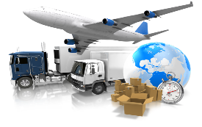

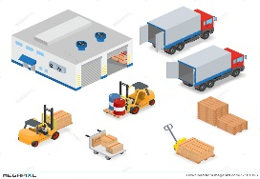
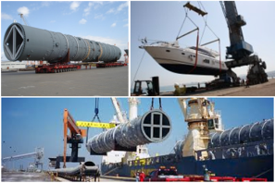
OUR SERVICES
Customs Clearance by Air and Sea
Supply Chain & Logistics Solutions
Freight Forwarding by Air and Sea
Warehousing and distribution
Project Cargo
Third Party Logistics (3PL)

Slide 7
OUR SERVICES
Custom House Brokerage
Having license on Pan India basis
Direct On line EDI connectivity with Indian CustomS
Sea Freight
Arranging Regular sailings on reliable liner vessels to & from major ports (20ft, 40ft, any special equipment)
Arranging LCL consignments
Air Freight
Offering attractive rates to & from major air ports on reliable airlines
Offering committed transit time
Warehousing and Distribution
Documentation & Insurance
Expertise documents
Faster service
Packing & Transportation
Latest Method of Packing the cargo
Expertise on Clearance of many types of cargos
Deploying skilled staffs for Documentation / Operation /Customer service/ Accounts / Sales on both Air and Sea.
Guidance on Import and Export procedures, Tariffs Schemes and benefits etc
To & from major ports
Offer Insurance services for both Inbound & Outbound cargos by Air & Sea
All type of cargo with attractive payment options.
Covered warehouse spaces in India and abroad to provide tailor-made services.
Separate warehouse for Airfreight and Ocean Freight Cargo
Distribution and door delivery to the possible corners of the country
We have our own vehicle to pick up cargo and to deliver the cargo in and around Chennai, Bangalore, Krishnapatnam , Tuticorin etc
We arrange for Fumigation
Palletization for necessary cargo

Slide 8










OUR CUSTOMERS

Slide 9

Why EASYWAY?
Overall operator arrange , can send you payload fast and safe to conclusive goal
Proficient DC , make consistent association with all online business stage
Budgetary coordination's stage will ensure the exchanges among shipper and proctor increasingly steady and significantly greater adaptability in utilizing capital.
Proficient coordination's and bound distribution center involvement with expert group

Slide 10


